Slide 1

IoT- From the Microcontroller to the Cloud Pooya Aliyarzadeh Summersemester 2023

Slide 2
Table of contents
Objective
Challenges
Project Architecture
Border router
RSMB
IoT Device driver
S.A.U.L Driver
The Project Architecture
Python script as a bridge
Broker and data receiver on AWS

Slide 3
Objective
This project was to create an application which runs on a microcontroller and sends dynamic sensor data over the internet to a cloud service provided by Amazon Web Services (AWS).
We use nrf52840 dk as the main board and RIOT as the operating system

Slide 4
Challenges
Using MQTT-SN and MQTT
The board communicates over the 6Lo network (PAN) there needs to be a conversion to IPv6 in order to make the node accessible from the internet as well as to make the“outside world” accessible for the node
In fact MQTT-SN is a variation of the standard MQTT protocol and specific to sensor networks. It is specifically designed for sensors that work wirelessly and the main differences from MQTT are:
Limited payload size
implemented in a way that uses UDP instead of TCP

Slide 5
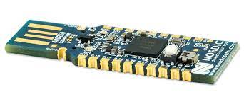
Border Router
The border-router is responsible to route messages between the 6Lo network and 'normal' IPv6 networks.
Usage of Gnrc_border_router example on nrf52840 Dongle

Slide 6
The Really Small Message Broker
Broker of choice for MQTT-SN in the RIOT emcute_mqttsn tutorial
to translate from MQTT-SN to MQTT

Slide 7
IoT-Device driver application
The application uses a SAUL-driver
It can than be fetched from the registry in the main programm and the read function can be called to get the generated data.

Slide 8
[S]ensor [A]ctuator [U]ber [L]ayer and the Driver
SAUL is a generic actuator/sensor interface in RIOT.
Its purpose is to enable unified interaction with a wide range of sensors and actuators through a set of defined access functions and a common data structure.
Each device driver implementing this interface has to expose a set of predefined functions and it has to register itself to the central SAUL registry.
SAUL-driver generates data that starts at 0 and counts up to 9 iterativly, every second. The driver needs to be initialized and and registered in the SAUL registry.

Slide 9
Python script as a bridge
To send the MQTT messages from the driver over the rsmb to AWS-Broker
The script subscribes to the rsmb and then publishes the message that was received to the AWS-Broker

Slide 10
Broker and data receiver on AWS
Using mosquitto to setup the broker on the EC2 Instance
an EC2 instance will be used to run the command and subscribe to the Broker running on the other EC2 instance.

Slide 11
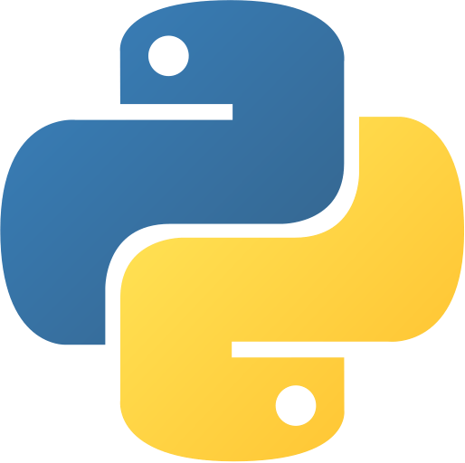


Project Architecture
Python script
to Route MQTT Packages to AWS
MQTT-SN/MQTT Broker
MQTT
AWS EC2-Instance1
MQTT-SN
Border-Router
Broker
Send data via MQTT-SN
Subscribe to AWS EC2- instance 1
AWS EC2-Instance2

Slide 12


Questions?!

